Slide 1
Communicating With Data
Phillip Lear
phillip.lear@kellogg.com
4/7/2021

Slide 2
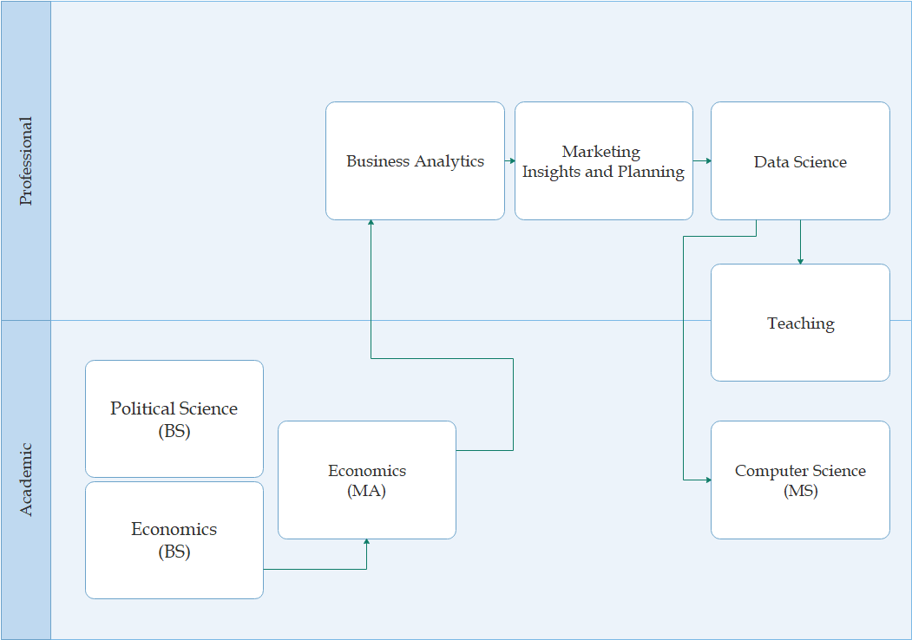






Phillip Lear
about me

Slide 3

expressing information
comparing ways of displaying data
communicating with data
design ideas
agenda
inspiration from visualization experts
the grammar of graphics
application in building a plot
https://github.com/plear/GVSU_EconClubPrez

Slide 4
expressing information
“In God we trust. All others must bring data.”
- W. Edwards Deming

Slide 5
Insight
Information vs.
Data vs.

Slide 6
Simple Data
Which does a better job of conveying information?
“Our share of category is up year over year.”

Slide 7
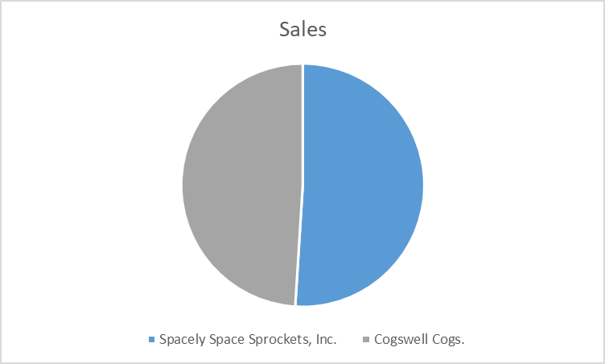
Simple Data
Which does a better job of conveying information?

Slide 8
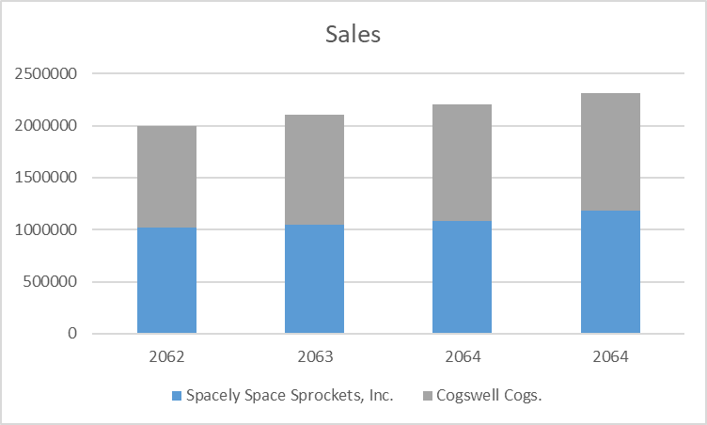
Simple Times Series Data
Which does a better job of conveying information?

Slide 9
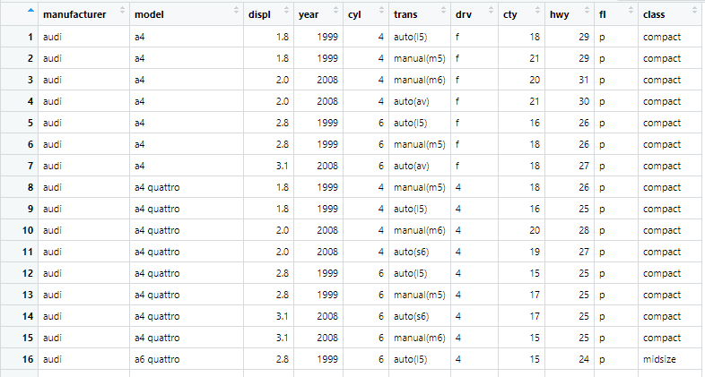
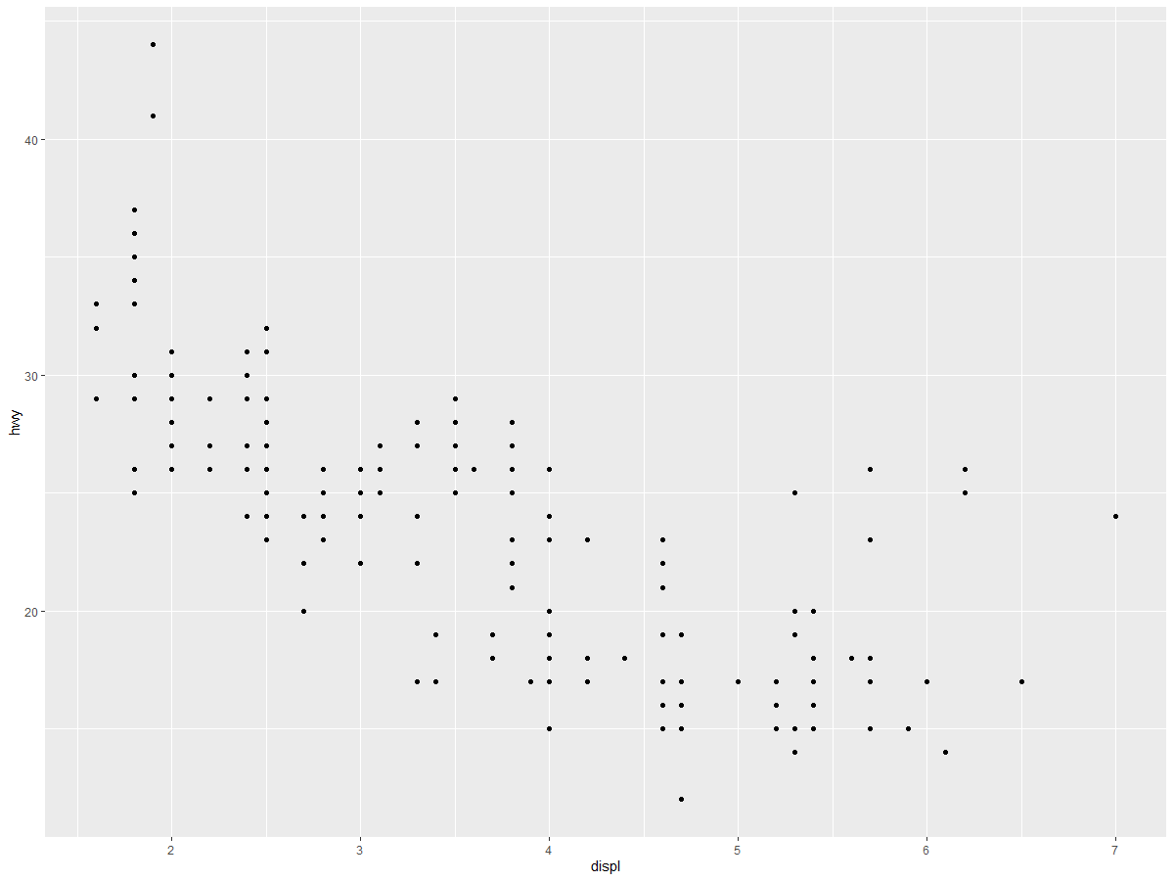
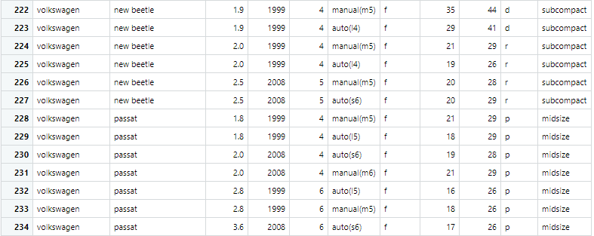
Small data sets with multiple factors
Are these comparable?
{…}

Slide 10
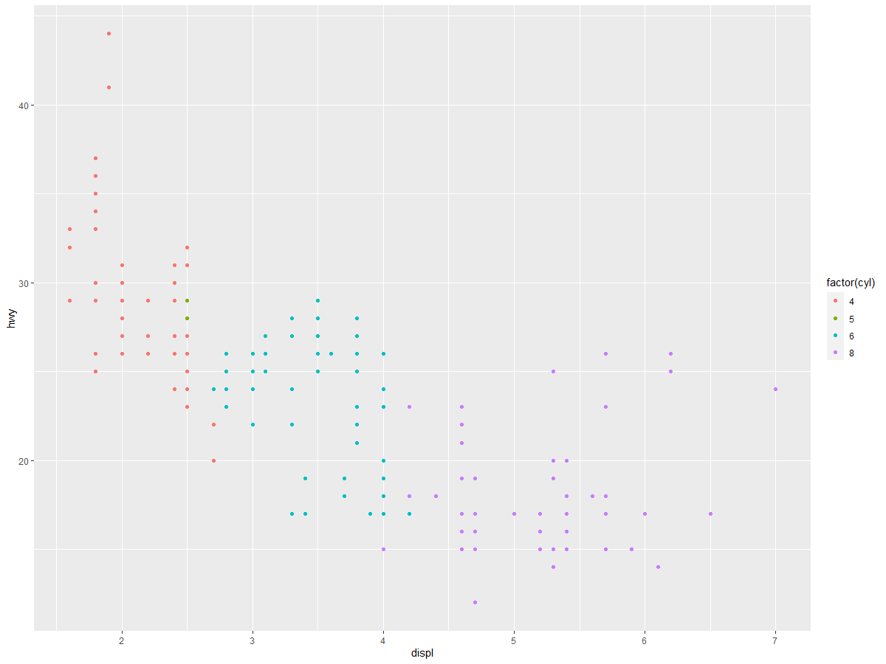
Small data sets with multiple factors
Are these comparable?
{…}

Slide 11
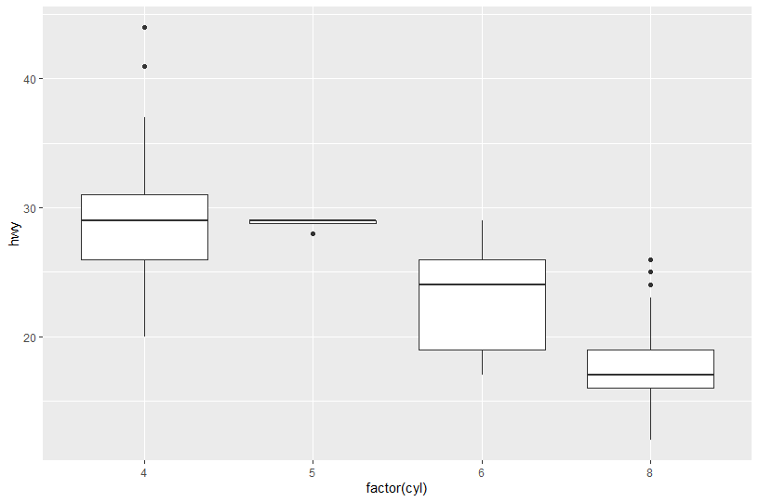
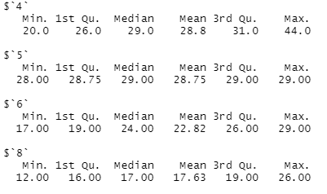
Analysis of summary statistics
Which tells a better story?

Slide 12
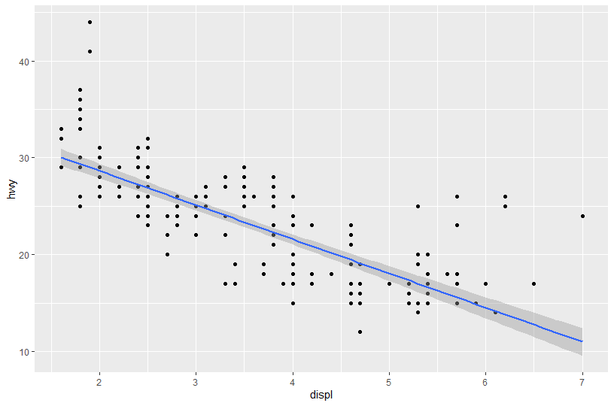
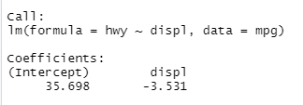
Analysis of modeled data
Which tells a better story?

Slide 13
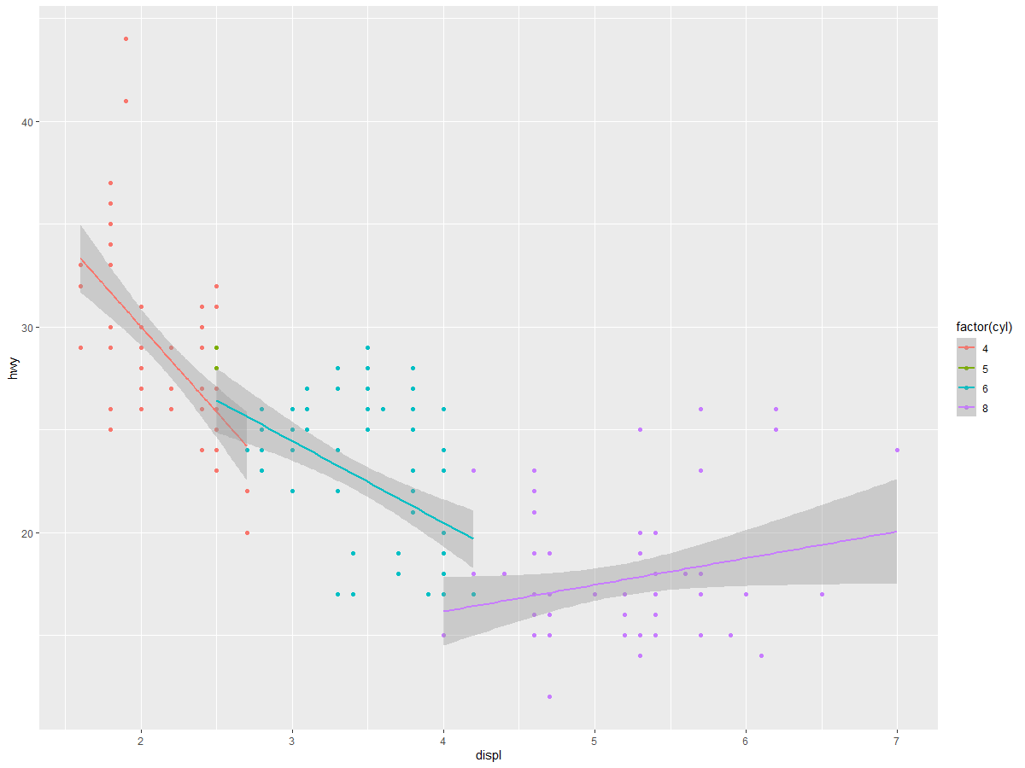
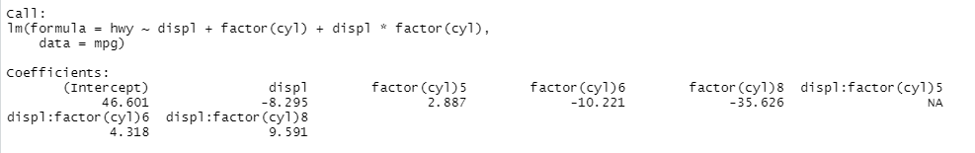
Analysis of modeled data
Which tells a better story?

Slide 14
design ideas
“The greatest value of a picture is when it forces us to notice what we never expected to see.”
- John W. Tukey

Slide 15
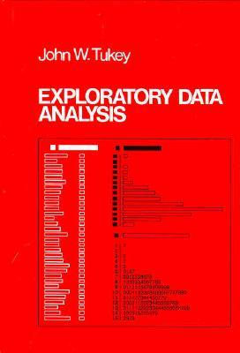
Exploratory Data Analysis
John W. Tukey
“Far better an approximate answer to the right question, which is often vague, than an exact answer to the wrong question, which can always be made precise.”

Slide 16
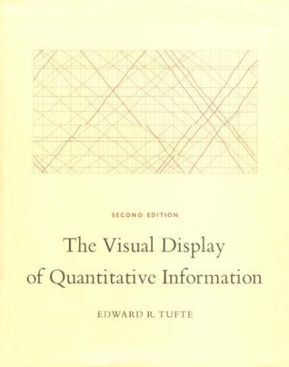
The Visual Display
of Quantitative Information
Edward R. Tufte
“Graphical excellence is that which gives to the viewer the greatest number of ideas in the shortest time with the least ink in the smallest space.”

Slide 17

the truthful art
Albert Cairo
“The purpose of infographics and data visualizations is to enlighten people — not to entertain them, not to sell them products, services, or ideas, but to inform them. It’s as simple — and complicated — as that.”

Slide 18
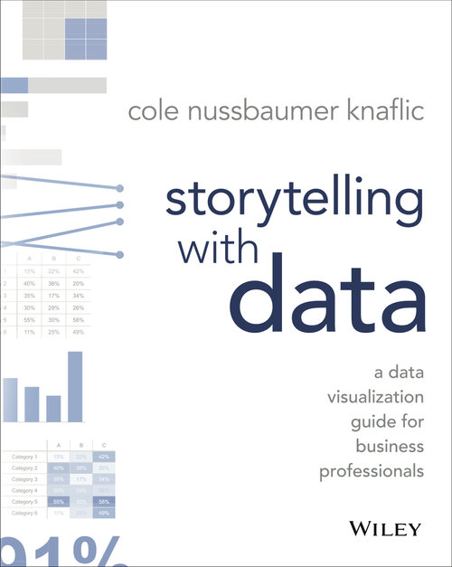
Storytelling with data
Cole Nussbaumer Knaflic
“When we’re at the point of communicating our analysis to our audience, we really want to be in the explanatory space, meaning you have a specific thing you want to explain, a specific story you want to tell—probably about those two pearls.”

Slide 19
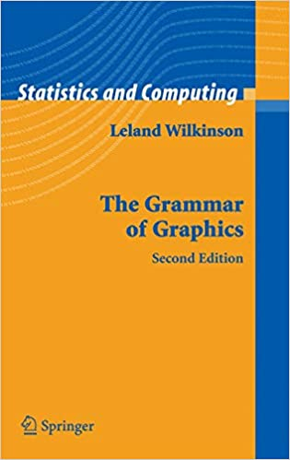
The Grammar of Graphics
Leland Wilkinson
“The grammar of graphics takes us beyond a limited set of charts (words) to an almost unlimited world of graphical forms (statements)”
https://research.tableau.com/user/leland-wilkinson

Slide 20
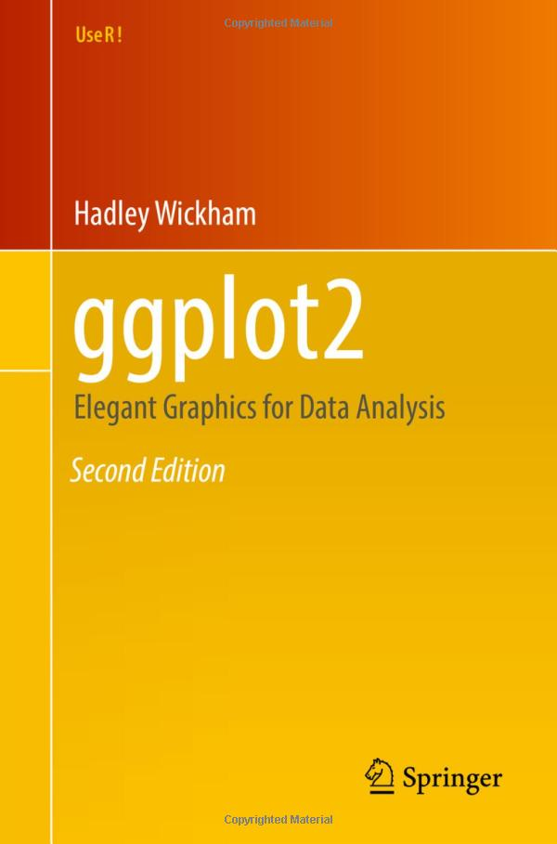
ggplot2
Hadley Wickham
“ggplot2 is designed to work iteratively.
You start with a layer that shows the raw data.
Then you add layers of annotations and statistical summaries.
This allows you to produce graphics using the same structured thinking that you would use to design an analysis.”
https://ggplot2-book.org/index.html
https://vita.had.co.nz/papers/layered-grammar.pdf

Slide 21
the grammar of graphics
“The simple graph has brought more information to the data analyst’s mind than any other device.” — John Tukey

Slide 22

library(ggplot2)
library(gapminder)
ggplot(data=gapminder)

Slide 23
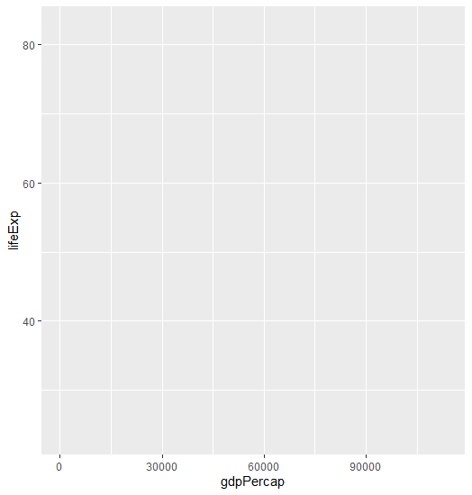
library(ggplot2)
library(gapminder)
ggplot(data=gapminder,
aes(x=gdpPercap, y=lifeExp))

Slide 24
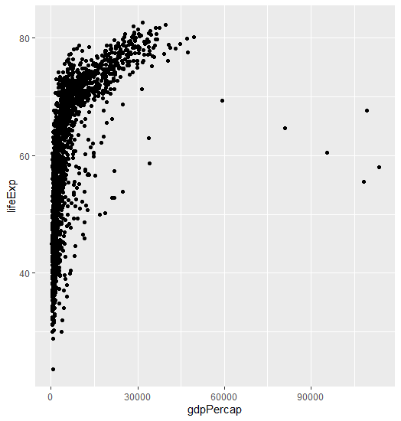
library(ggplot2)
library(gapminder)
ggplot(data=gapminder,
aes(x=gdpPercap, y=lifeExp)) +
geom_point()

Slide 25
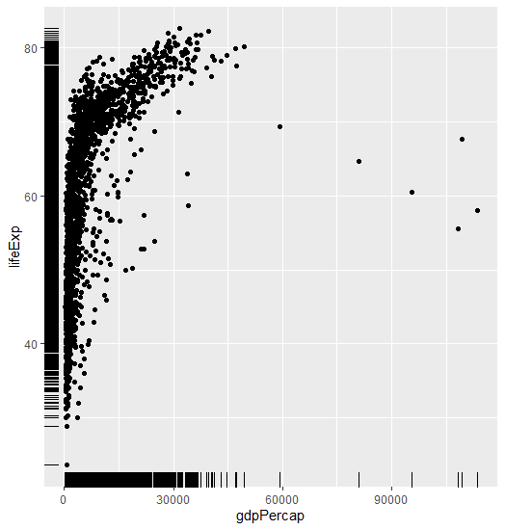
library(ggplot2)
library(gapminder)
ggplot(data=gapminder,
aes(x=gdpPercap, y=lifeExp)) +
geom_point() +
geom_rug()

Slide 26
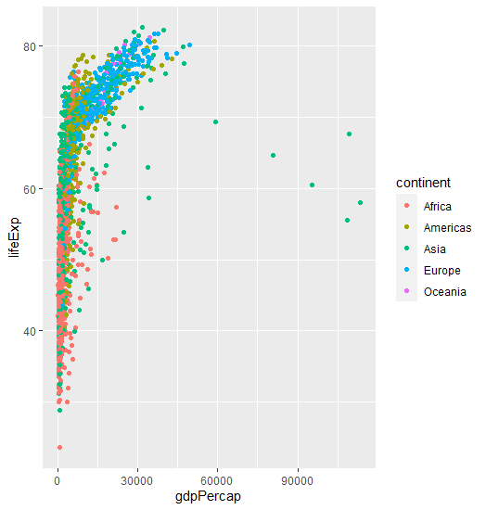
library(ggplot2)
library(gapminder)
ggplot(data=gapminder,
aes(x=gdpPercap, y=lifeExp,
color = continent)) +
geom_point()

Slide 27
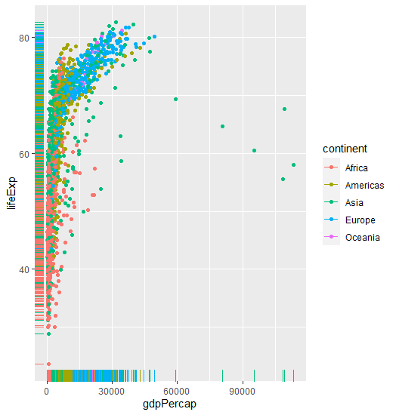
library(ggplot2)
library(gapminder)
ggplot(data=gapminder,
aes(x=gdpPercap, y=lifeExp,
color = continent)) +
geom_point() +
geom_rug()

Slide 28
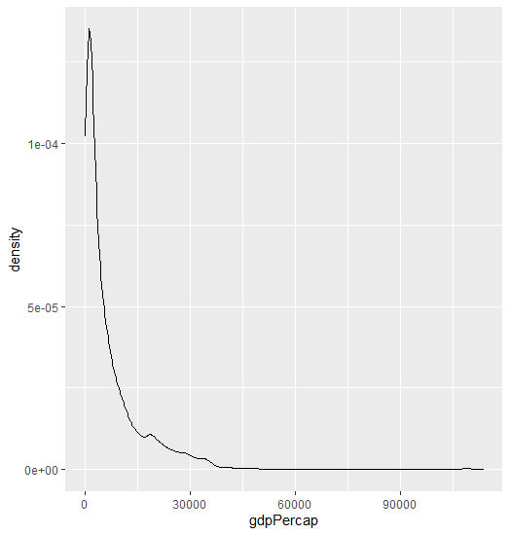
library(ggplot2)
library(gapminder)
ggplot(data=gapminder,
aes(x=gdpPercap)) +
geom_density()

Slide 29
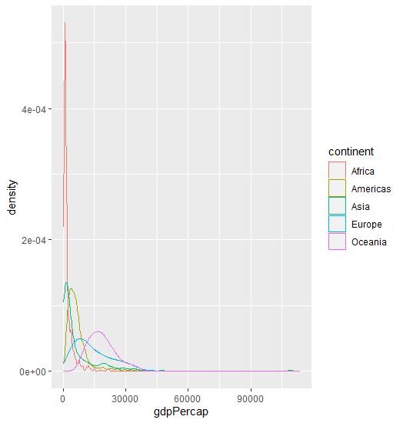
library(ggplot2)
library(gapminder)
ggplot(data=gapminder,
aes(x=gdpPercap, color=continent)) +
geom_density()

Slide 30
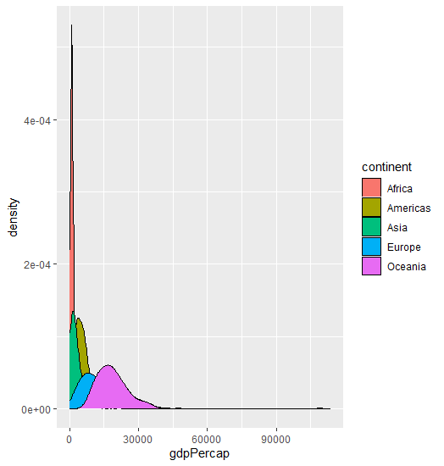
library(ggplot2)
library(gapminder)
ggplot(data=gapminder,
aes(x=gdpPercap, fill=continent)) +
geom_density()

Slide 31
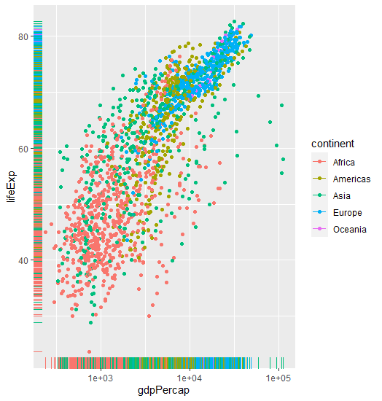
library(ggplot2)
library(gapminder)
ggplot(data=gapminder,
aes(x=gdpPercap, y=lifeExp,
color = continent)) +
geom_point() +
geom_rug() +
scale_x_log10()

Slide 32
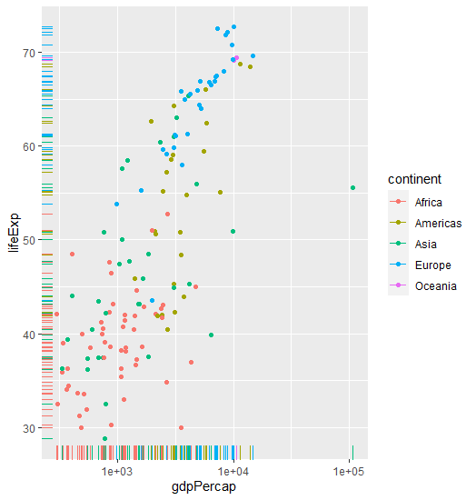
library(ggplot2)
library(dplyr)
library(gapminder)
ggplot(data=filter(gapminder, year==1952),
aes(x=gdpPercap, y=lifeExp,
color = continent)) +
geom_point() +
geom_rug() +
scale_x_log10()

Slide 33
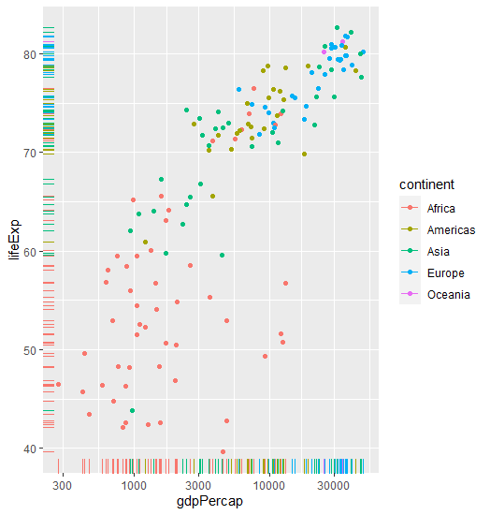
library(ggplot2)
library(dplyr)
library(gapminder)
ggplot(data=filter(gapminder, year==2007),
aes(x=gdpPercap, y=lifeExp,
color = continent)) +
geom_point() +
geom_rug() +
scale_x_log10()

Slide 34
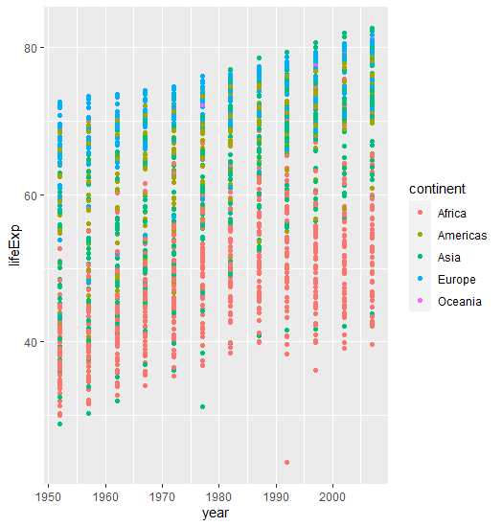
library(ggplot2)
library(gapminder)
ggplot(data=gapminder, aes(x=year, y=lifeExp,
color = continent)) +
geom_point()

Slide 35
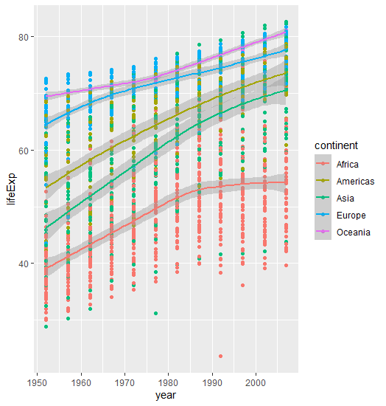
library(ggplot2)
library(gapminder)
ggplot(data=gapminder, aes(x=year, y=lifeExp,
color = continent)) +
geom_point() +
geom_smooth()

Slide 36
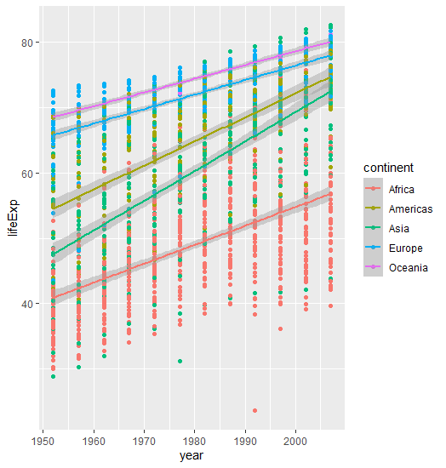
library(ggplot2)
library(gapminder)
ggplot(data=gapminder, aes(x=year, y=lifeExp,
color = continent)) +
geom_point() +
geom_smooth(method="lm")

Slide 37
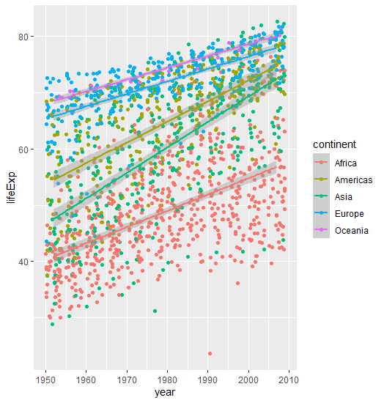
library(ggplot2)
library(gapminder)
ggplot(data=gapminder, aes(x=year, y=lifeExp,
color = continent)) +
geom_jitter() +
geom_smooth(method="lm")

Slide 38
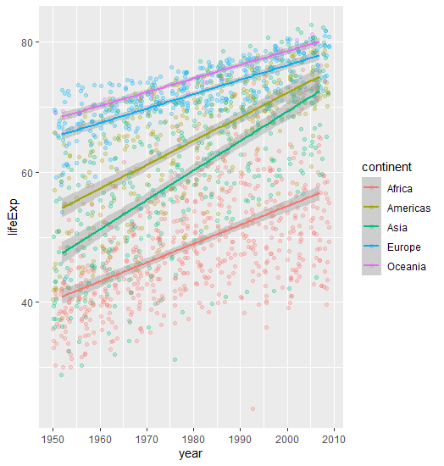
library(ggplot2)
library(gapminder)
library(dplyr)
ggplot(data=gapminder, aes(x=year, y=lifeExp,
color = continent)) +
geom_jitter(alpha=0.25) +
geom_smooth(method="lm")

Slide 39
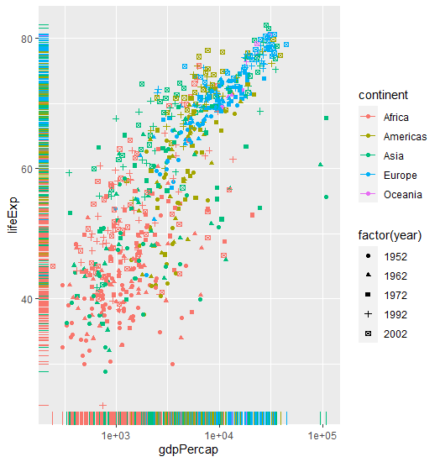
library(ggplot2)
library(gapminder)
library(dplyr)
ggplot(data=
filter(gapminder, year %in%
c(1952, 1962, 1972, 1992, 2002)),
aes(x=gdpPercap, y=lifeExp,
color=continent, shape=year)) +
geom_point() +
geom_rug() +
scale_x_log10()

Slide 40
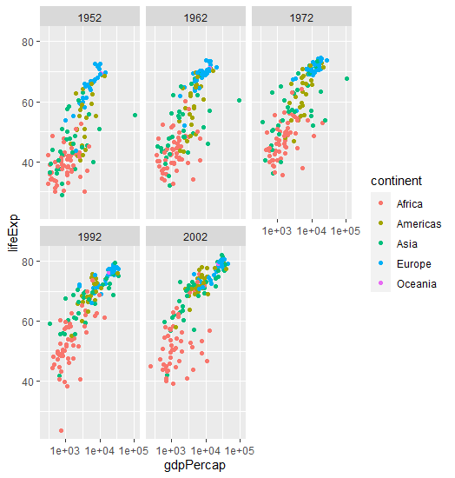
library(ggplot2)
library(gapminder)
library(dplyr)
ggplot(data=
filter(gapminder, year %in%
c(1952, 1962, 1972, 1992, 2002)),
aes(x=gdpPercap, y=lifeExp,
color = continent)) +
geom_point() +
scale_x_log10() +
facet_wrap(.~year)

Slide 41
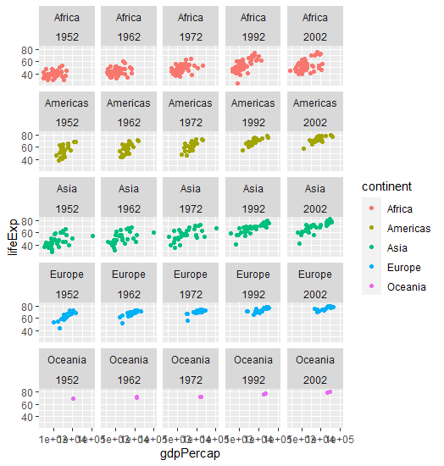
library(ggplot2)
library(gapminder)
library(dplyr)
ggplot(data=
filter(gapminder, year %in%
c(1952, 1962, 1972, 1992, 2002)),
aes(x=gdpPercap, y=lifeExp,
color = continent)) +
geom_point() +
scale_x_log10() +
facet_wrap(continent~year)

Slide 42
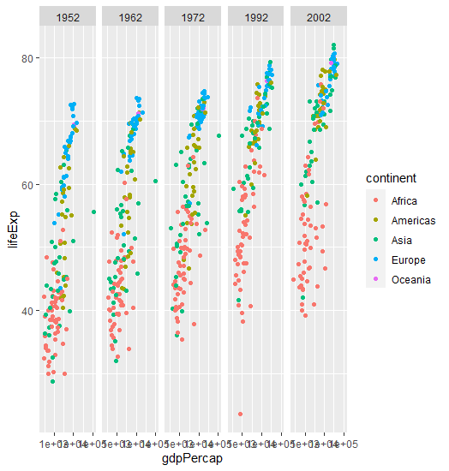
library(ggplot2)
library(gapminder)
library(dplyr)
ggplot(data=
filter(gapminder, year %in%
c(1952, 1962, 1972, 1992, 2002)),
aes(x=gdpPercap, y=lifeExp,
color = continent)) +
geom_point() +
scale_x_log10() +
facet_grid(~year)

Slide 43
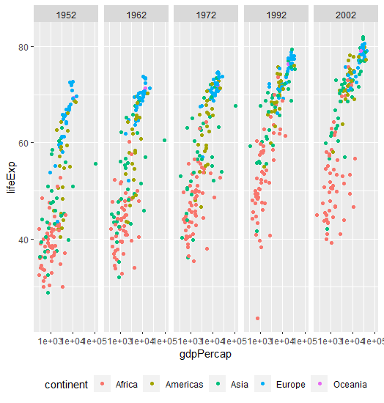
library(ggplot2)
library(gapminder)
library(dplyr)
ggplot(data=
filter(gapminder, year %in%
c(1952, 1962, 1972, 1992, 2002)),
aes(x=gdpPercap, y=lifeExp,
color = continent)) +
geom_point() +
scale_x_log10() +
facet_grid(~year) +
theme(legend.position = “bottom”)

Slide 44
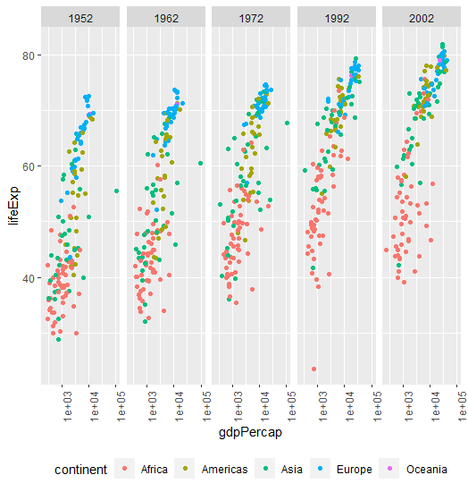
library(ggplot2)
library(gapminder)
library(dplyr)
ggplot(data=
filter(gapminder, year %in%
c(1952, 1962, 1972, 1992, 2002)),
aes(x=gdpPercap, y=lifeExp,
color = continent)) +
geom_point() +
scale_x_log10() +
facet_grid(~year) +
theme(legend.position = “bottom”,
axis.text.x=element_text(angle=90))

Slide 45
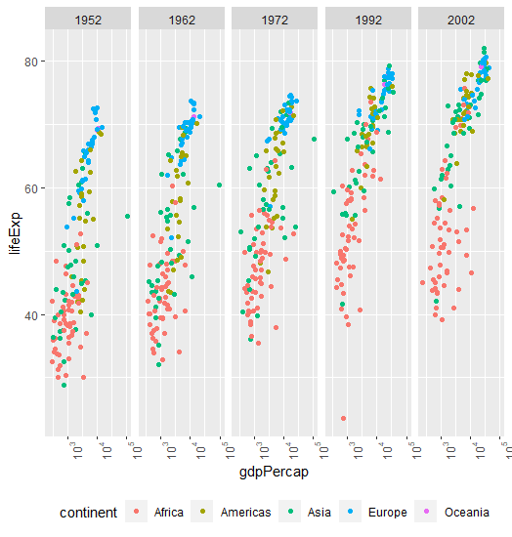
library(ggplot2)
library(gapminder)
library(dplyr)
ggplot(data=
filter(gapminder, year %in%
c(1952, 1962, 1972, 1992, 2002)),
aes(x=gdpPercap, y=lifeExp,
color = continent)) +
geom_point() +
scale_x_log10(labels = scales::trans_format("log10", scales::math_format(10^.x))) +
facet_grid(~year) +
theme(legend.position = “bottom”,
axis.text.x=element_text(angle=90))

Slide 46
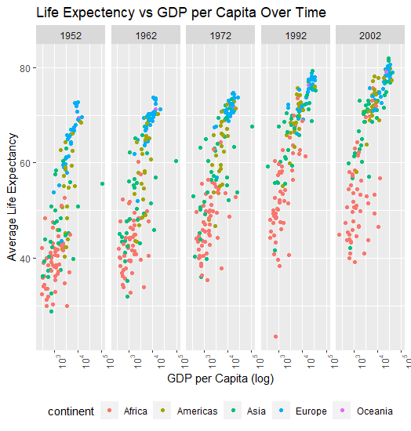
library(ggplot2)
library(gapminder)
library(dplyr)
ggplot(data=
filter(gapminder, year %in%
c(1952, 1962, 1972, 1992, 2002)),
aes(x=gdpPercap, y=lifeExp,
color = continent)) +
geom_point() +
scale_x_log10(labels = scales::trans_format("log10", scales::math_format(10^.x))) +
facet_grid(~year) +
theme(legend.position = “bottom”,
axis.text.x=element_text(angle=90))+
labs(title = "Life Expectency vs GDP per Capita Over Time",
x = "GDP per Capita (log)",
y = "Average Life Expectancy")

Slide 47
THANKS!!!
Phillip.lear@kellogg.com

